Slide 1
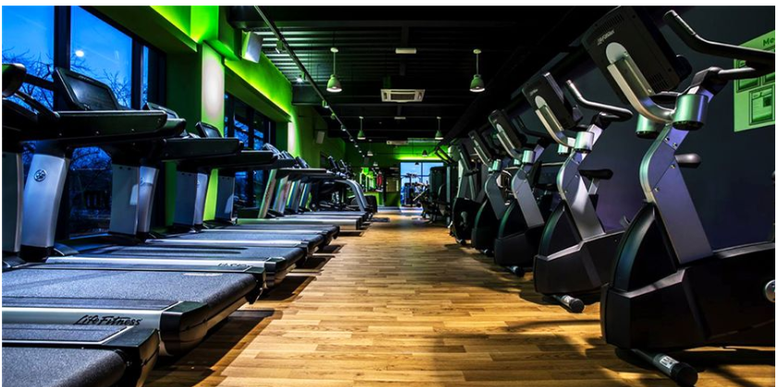
GYM MEMBERS MANAGEMENT SYSTEM
Course Instructor: Sir Asim mansha
Students
WAQAS NAEEM 39096
MIRZA ABDULLAH 57055

Slide 2

Table of Contents
Abstract
Introduction
Project Specification
conclusion

Slide 3
Abstract
Objectives of the project of this Gym Management System shall enable the user to add members to a gym and manage the fee payment of the gym user. It is a very simple interface developed using linked list. The user of the system shall be able to add a new gym member. The tool shall add all the necessary details like name, admission date, Address, contact details, weight of member, exercise name into the system. The Gym Management System also enables the user to update information of member. It shall allow the user to make fee payments. This tool shall hold all the details of gym members
It shall enable the user to delete the user record search the user record count the user record and give diet plan to the user The gym management system is a simple console application with the system is strictly protected by password information. The system has all the Member functions to list down the detail of gym members. that can be you manage your business efficiency. the gym management system is created in C++ programming language that can help in coding a structure to easily understand by new beginners

Slide 4

Introduction
Prerequisites:
➢ Linked list
Created a Gym Members Record Management system that can perform the following operations:
➢ Insert Record
➢ Search Record
➢ Update Record
➢ Delete Record
➢ Count Record
➢ Show Record
➢ Fee function
➢ Diet plan function

Slide 5
Description
➢ Count Record:
Count record counts the number of members in the linked list.
➢ Delete Record:
Delete Record is similar to deleting a key from a linked list. Here the key is the id of member.
➢ Show Record:
It shows the record to printing all the elements of the Linked list.
➢ Fee Function:
It shows the fee of member.
➢ Diet plan:
It gives diet plan to the members according to their age.
➢ Check Record:
It is a utility function of creating a record it checks before insertion that the Record Already Exist or not. It uses the concept of checking for a Node with given Data in a linked list.
➢ Insert Record:
It is as simple as creating a new node in the Empty Linked list or inserting a new node in a non-Empty linked list.
➢ Search Record:
Search a Record is similar to searching for a key in the linked list. Here in the Gym record key is the Id of member as id is unique for every member.
➢ Update Record:
Update record is if u want to do changing in members record the use this function.

Slide 6

The Gym record should contains the following items:
➢ Name of Member
➢ Id of Member
➢ Address of Member
➢ Contact of Member
➢ Joining date of Member
➢ Weight of Member
➢ Exercise for member

Slide 7

Project Specification
Few things must be taken into under consideration:
➢ Id of Member must be used as a key to distinguish between two different records so while inserting record check whether this record already exists in our link list or not if it already exists then immediately report to the user that record already exists and if not insert that record in the link list.
➢ The record should be inserted in sorted order for this to make the Id of member a key and use the inserting node in the sorted linked list.

Slide 8
Use of OOPS and DSA concepts:
➢ Classes and objects
➢ Namespace
➢ Header files
➢ Pointers
➢ Link list
➢ Singly-linked list
File Handling:
➢ In this project we are using concepts of file handling when we
insert members record it writes in to a file and read data from
file. When we want to delete all record of members we use
remove function to delete file.

Slide 9
Login and Sign up
➢ When we compile our management system firstly we have to create our id then login page is open if we enter wrong user name error occurs and if we enter wrong password error also occurs and we have to again enter username and password when we enter write user name and password main menu is open

Slide 10
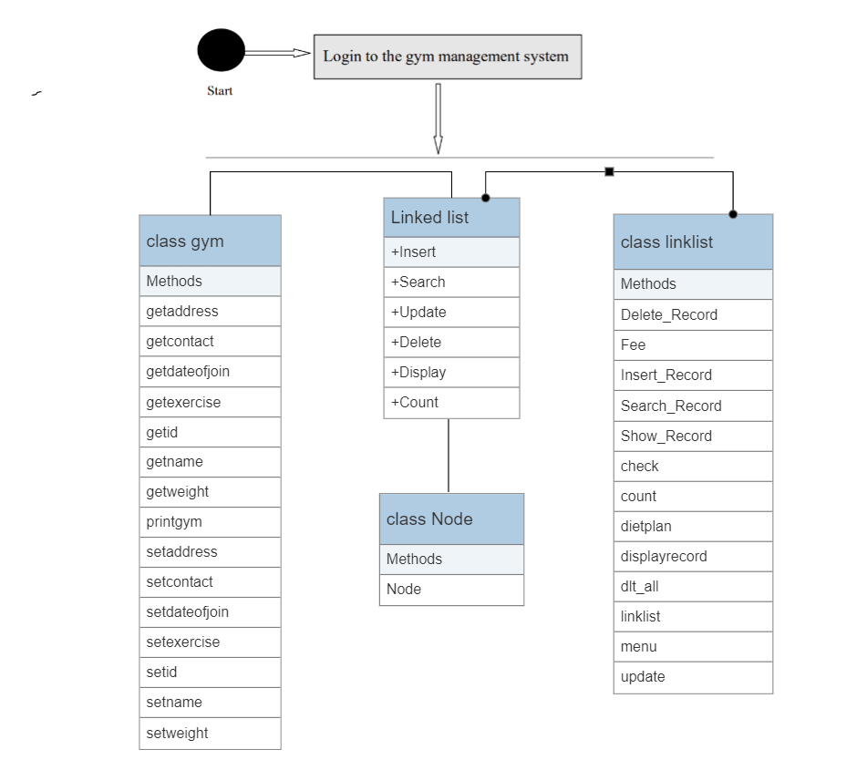
UML Diagram

Slide 11


